Slide 1
PechaKucha Slides
Jacob Goldsmith

Slide 2
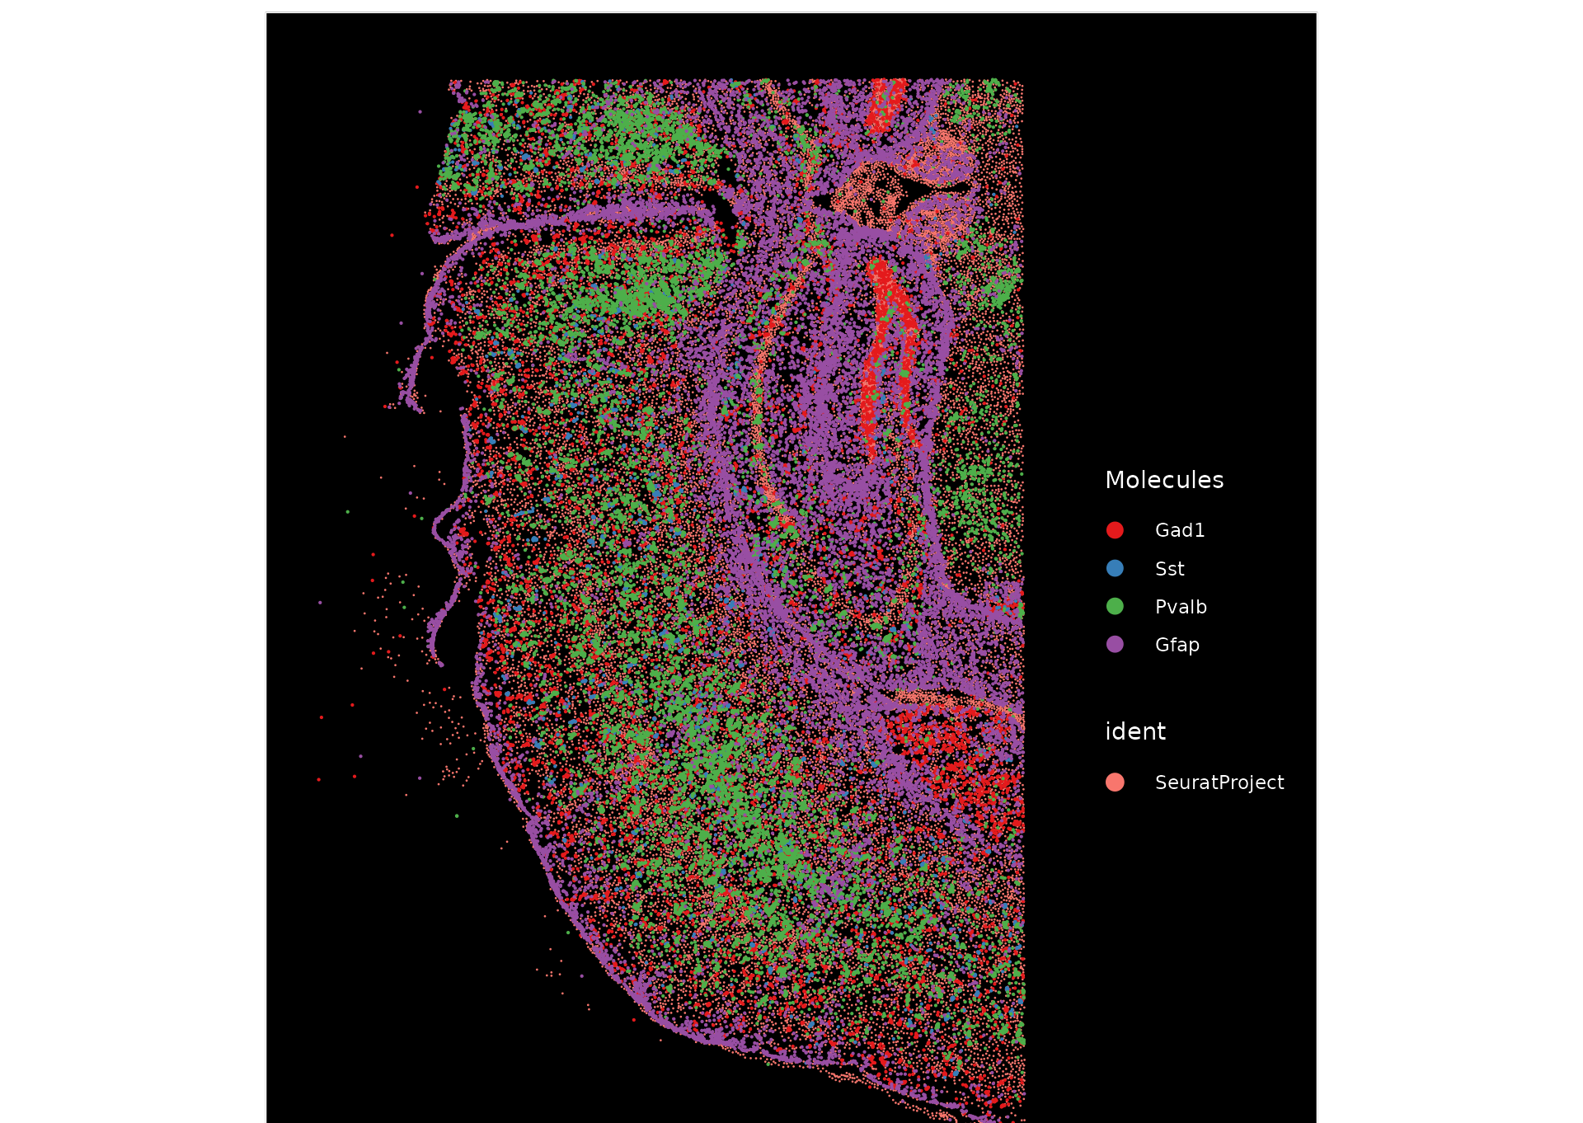
The challenge
Spatial transcriptomics lacks clear cell-type annotation; single-cell data provides gene expression but not location.

Slide 3
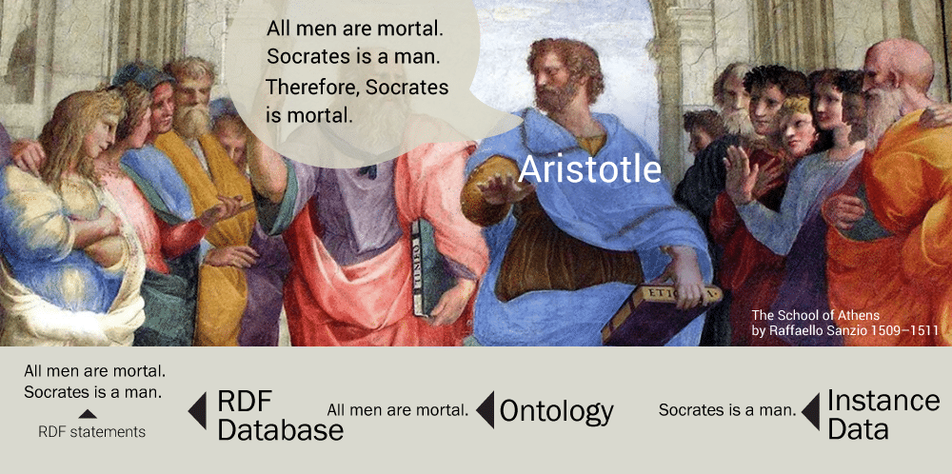
My approach
Use a semantic framework (graph DB that allows you to embed logic deterministic rules based on predicate calculus reasoner) and coexpression patterns to infer spatial cell types.

Slide 4
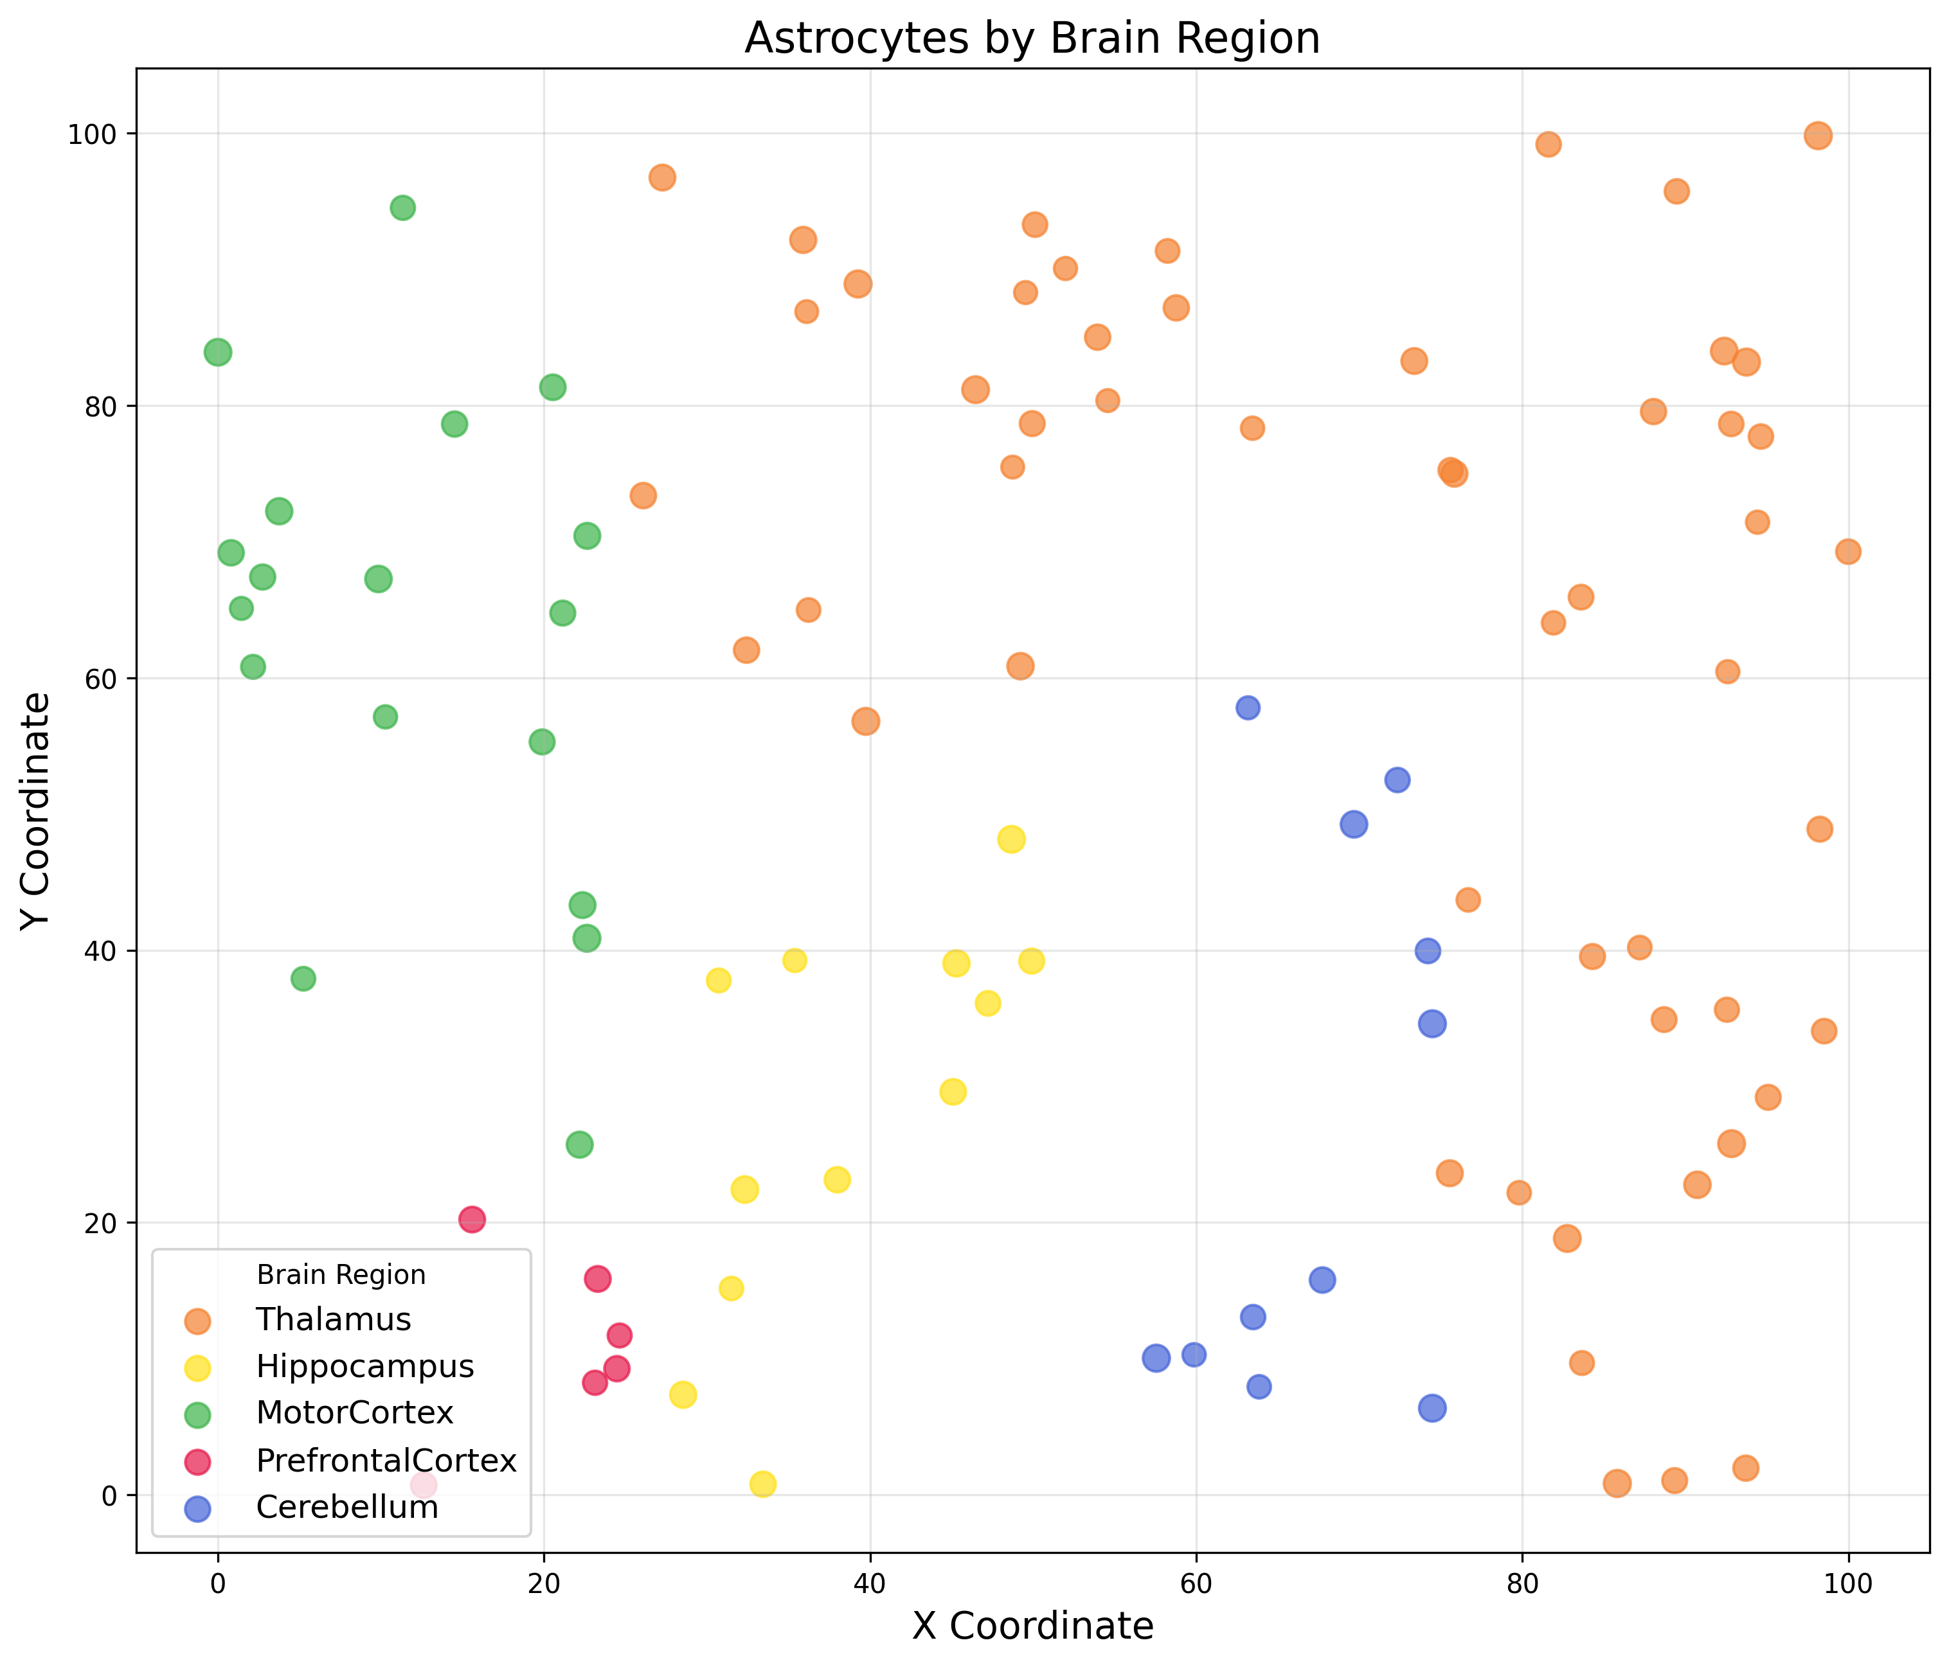
Why this matters
Understanding cell organization is key for disease research.

Slide 5
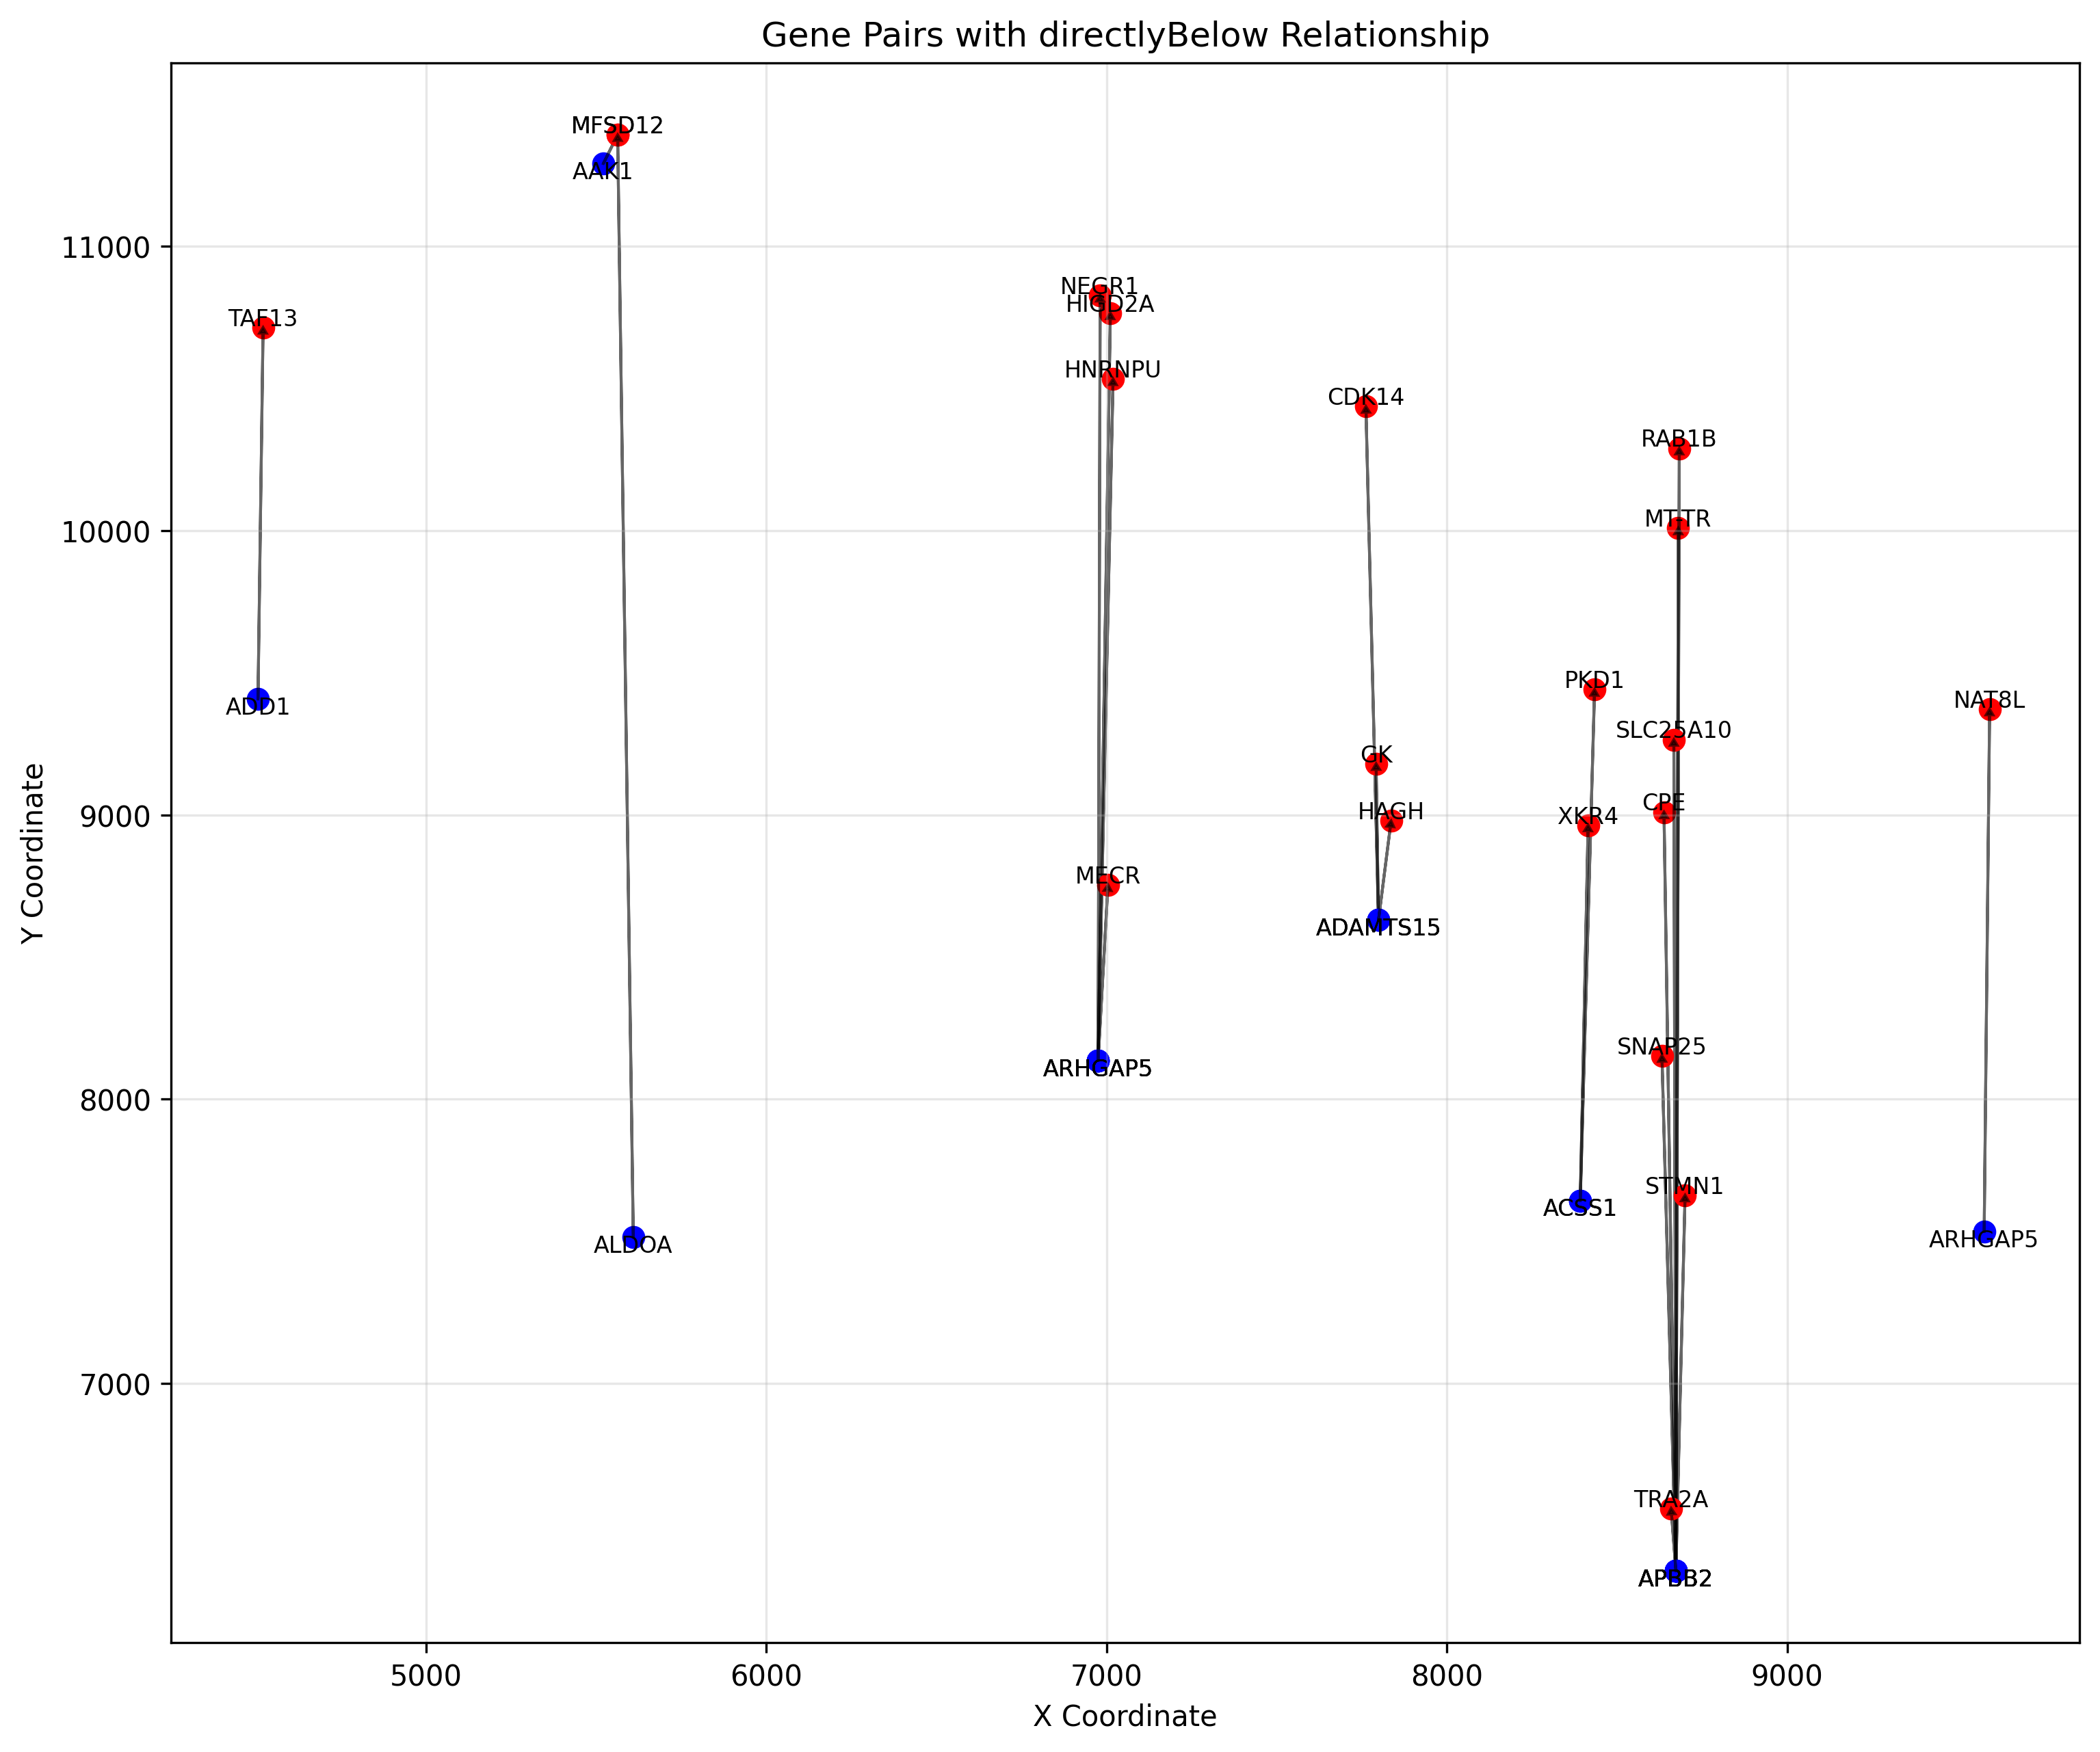
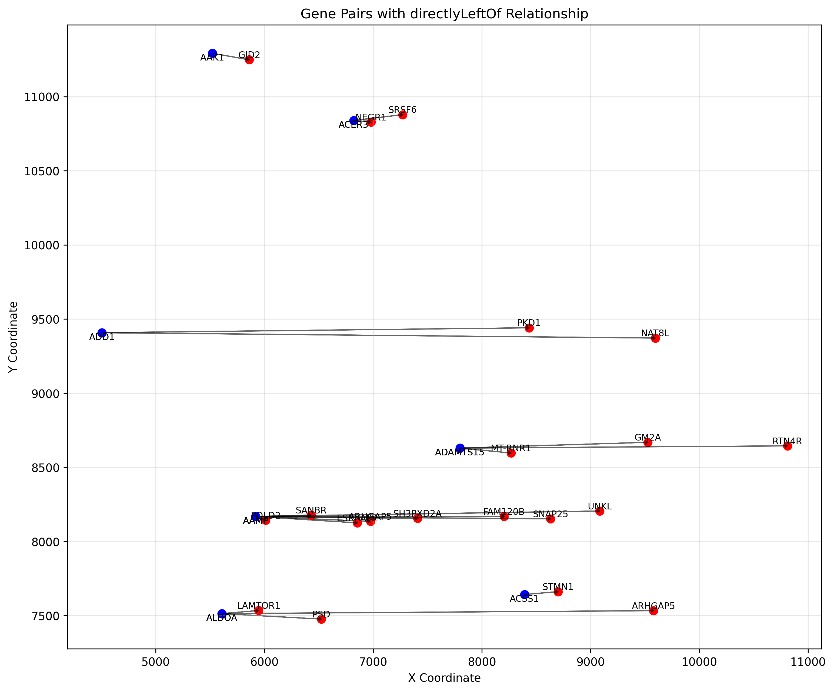
Personal motivation
Coming from a computational background, I had to quickly learn the biological complexity of these datasets.

Slide 6
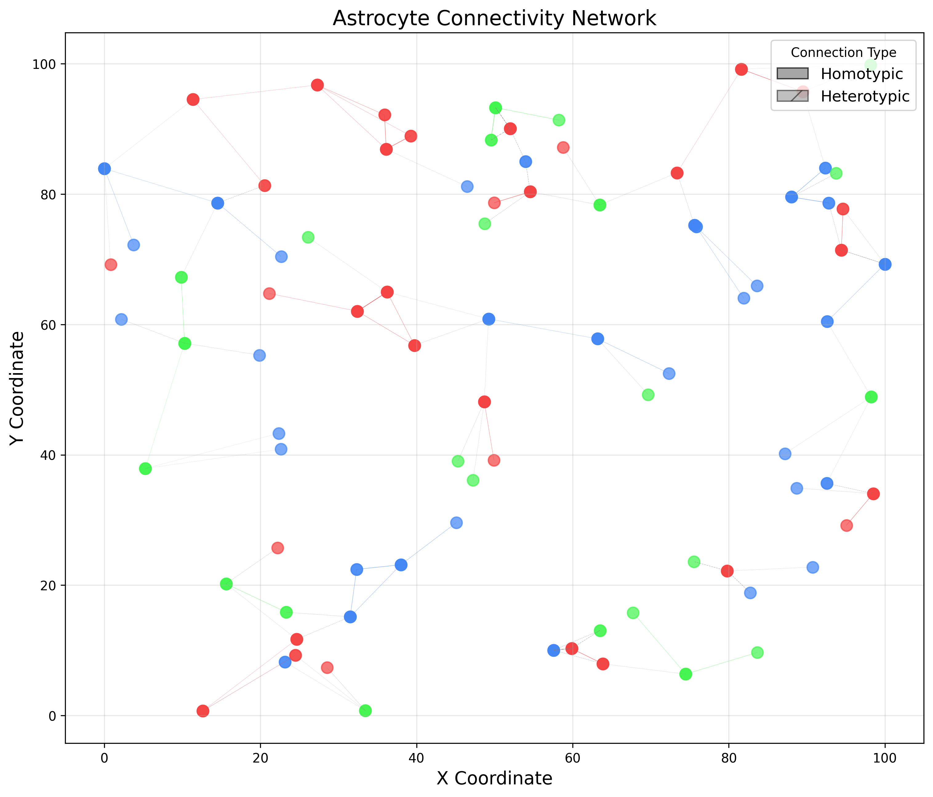
Main Question
Can single-cell expression patterns be used to map and classify cells in spatial data?

Slide 7
Major obstacles
Data loss, cell overlap, slicing artifacts, and highly similar gene expression across cell types.

Slide 8
Objectives
Develop an accurate computational approach that overcomes data loss, cell overlap, and segmentation challenges.

Slide 9
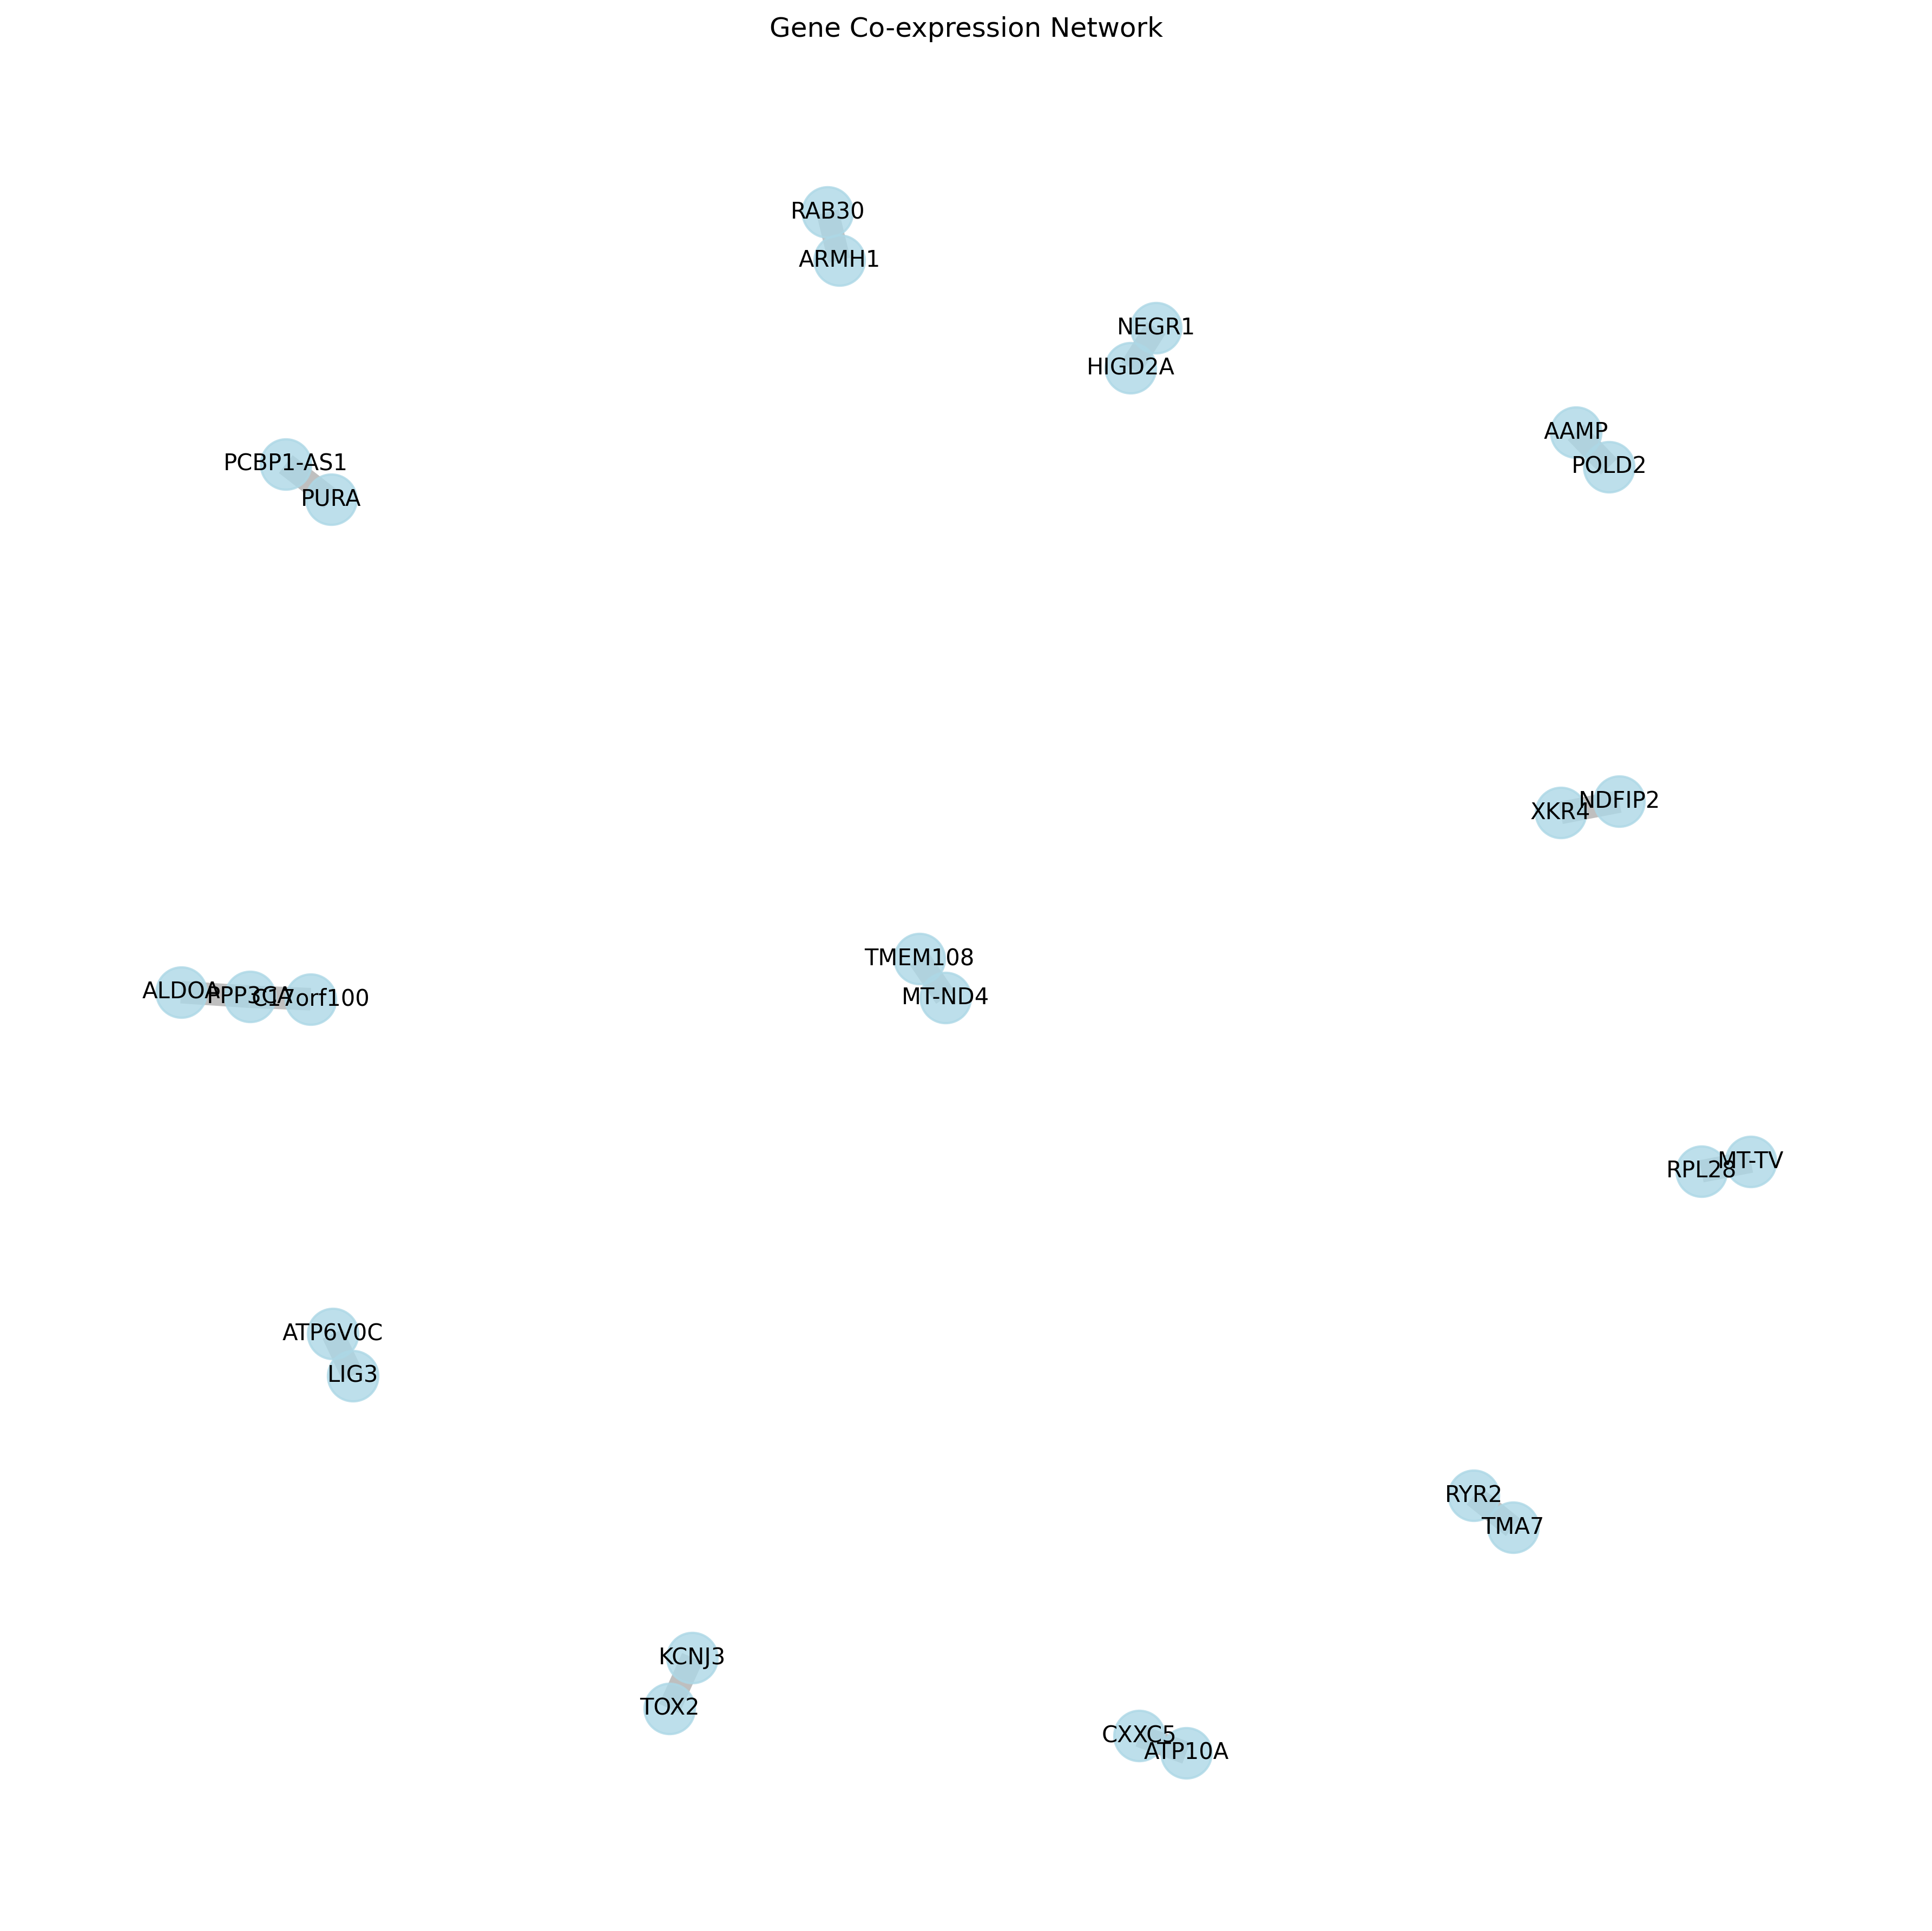
Refined approach
Coexpression and clique rules – Identify centroids of coexpressed genes and clique-based clusters.

Slide 10
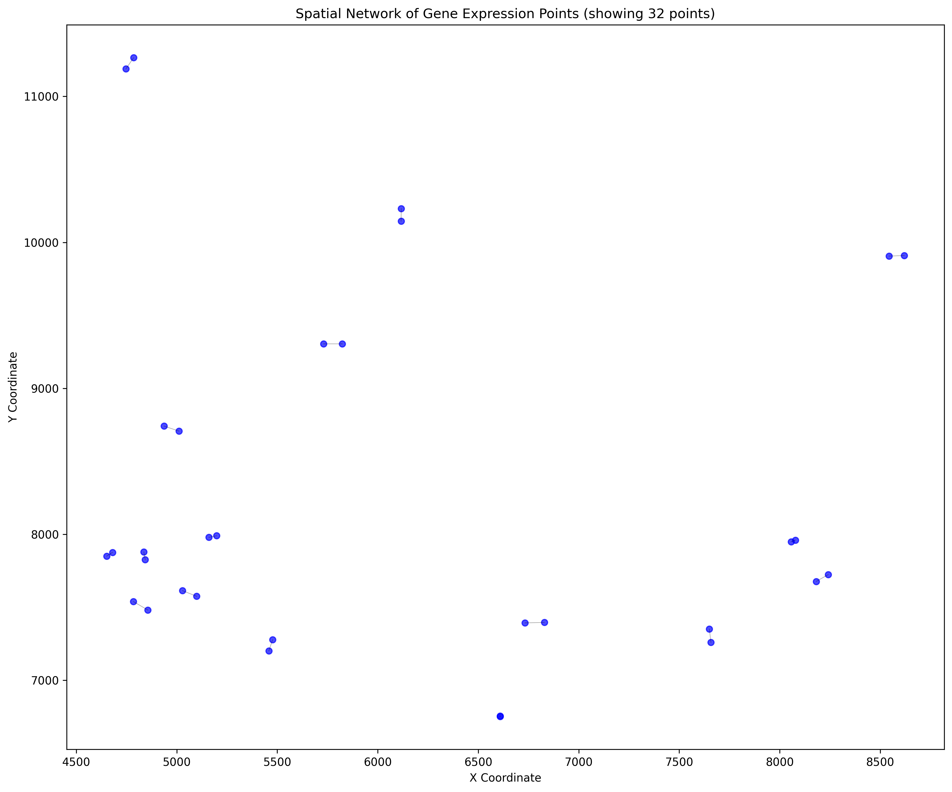
Expected outcome
A pipeline that enhances spatial cell identification for disease research.

Slide 11
Computational process
First pass finds general locations, second pass refines with clique rules, then final centroid calculation.

Slide 12
Challenges
Close proximity cells still interfere, and boundary identification remains difficult.

Slide 13
Breakthrough (but not the original objective)
Higher accuracy with coexpression/clique rules – Improved compared to direct mapping.
But only determined probable location, not the genes in the cell

Slide 14
Unexpected findings
Some cell types easier to identify, while neurons/astrocytes remain problematic.

Slide 15
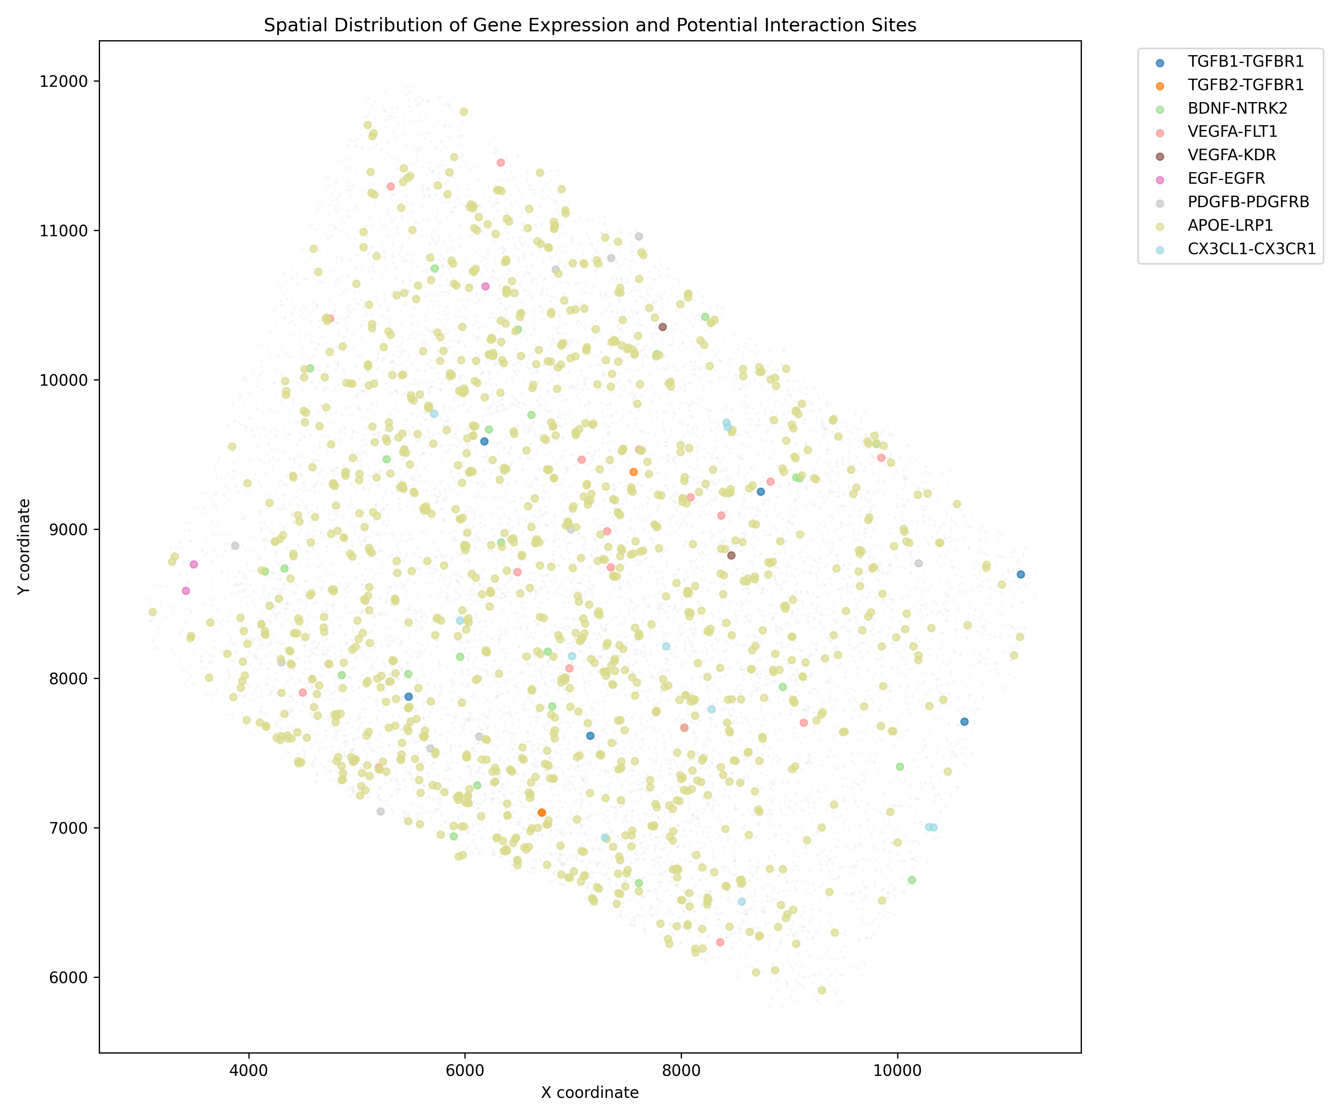
New project
Ligand-Receptor Pair Mapping – Identifying regions of high cellular communication.

Slide 16
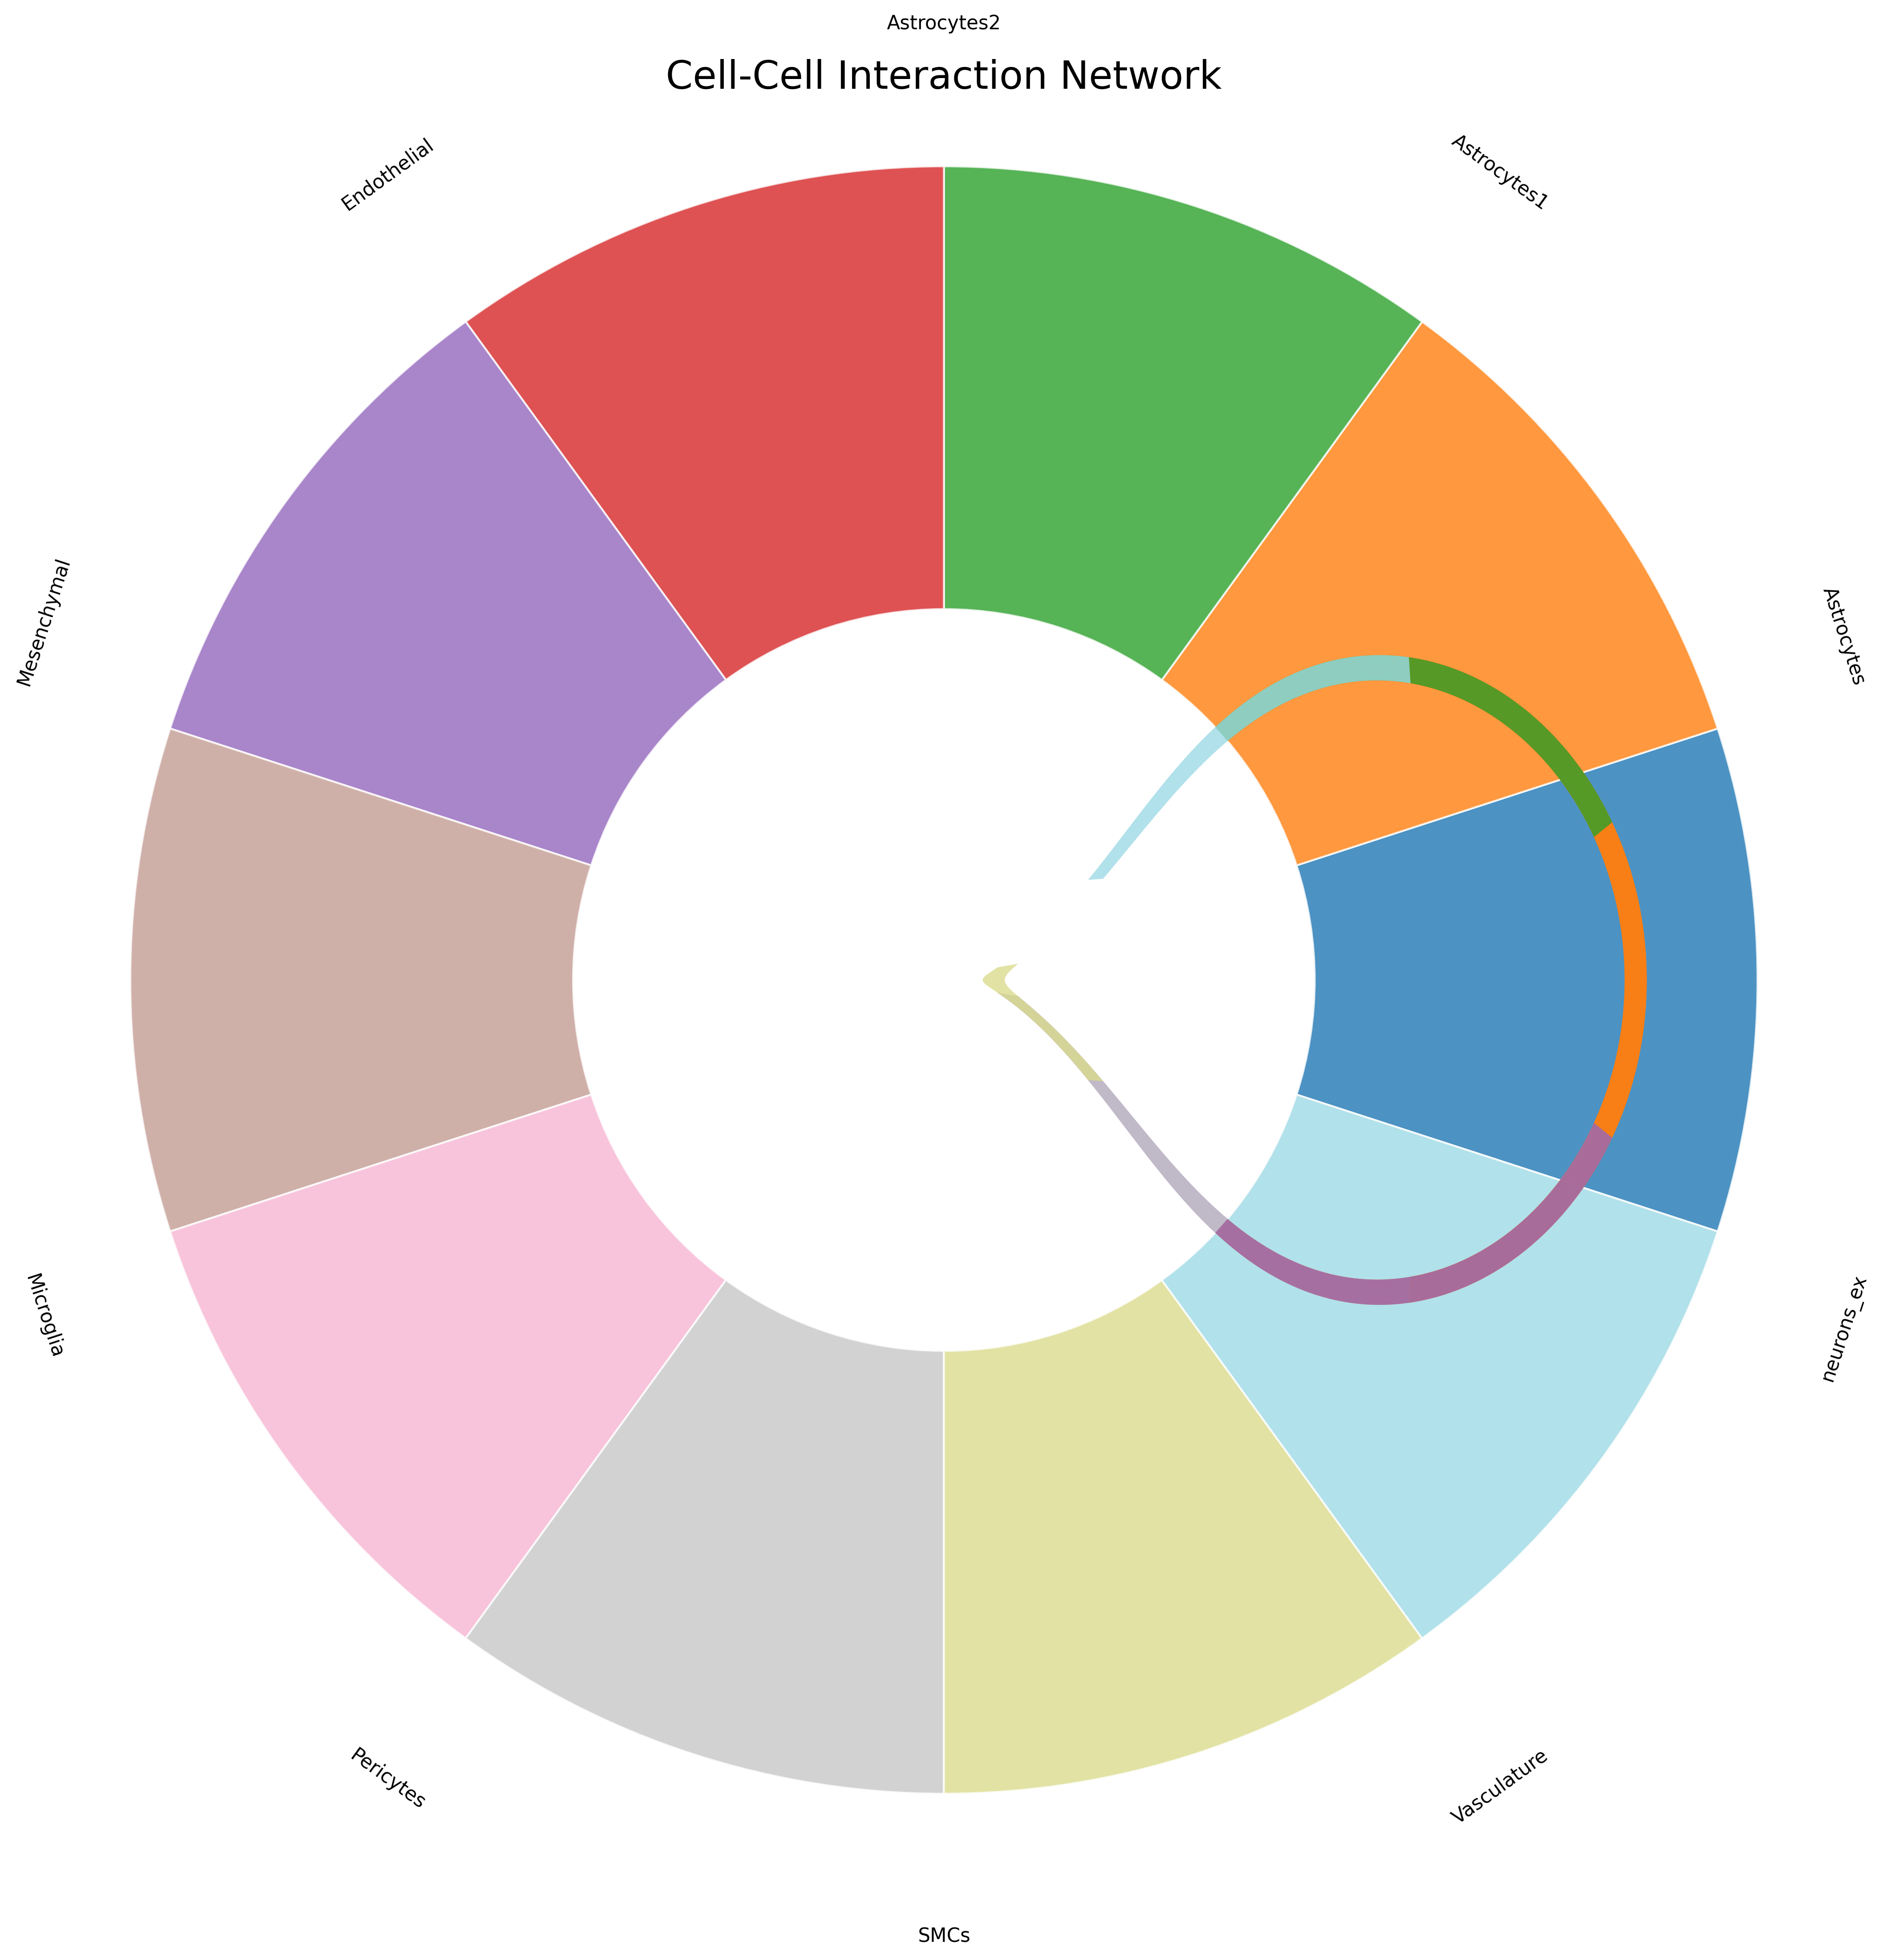
First Step Taken
Identified ligand receptor pairs from CellChatDB (I had to use R) that are present in cells in the single cell dataset

Slide 17
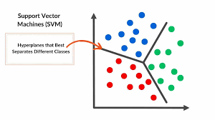
Application
Potential segmentation tool based on communication patterns.

Slide 18
Problems
Hard to separate true interactions from noise, and housekeeping genes still interfere.

Slide 19
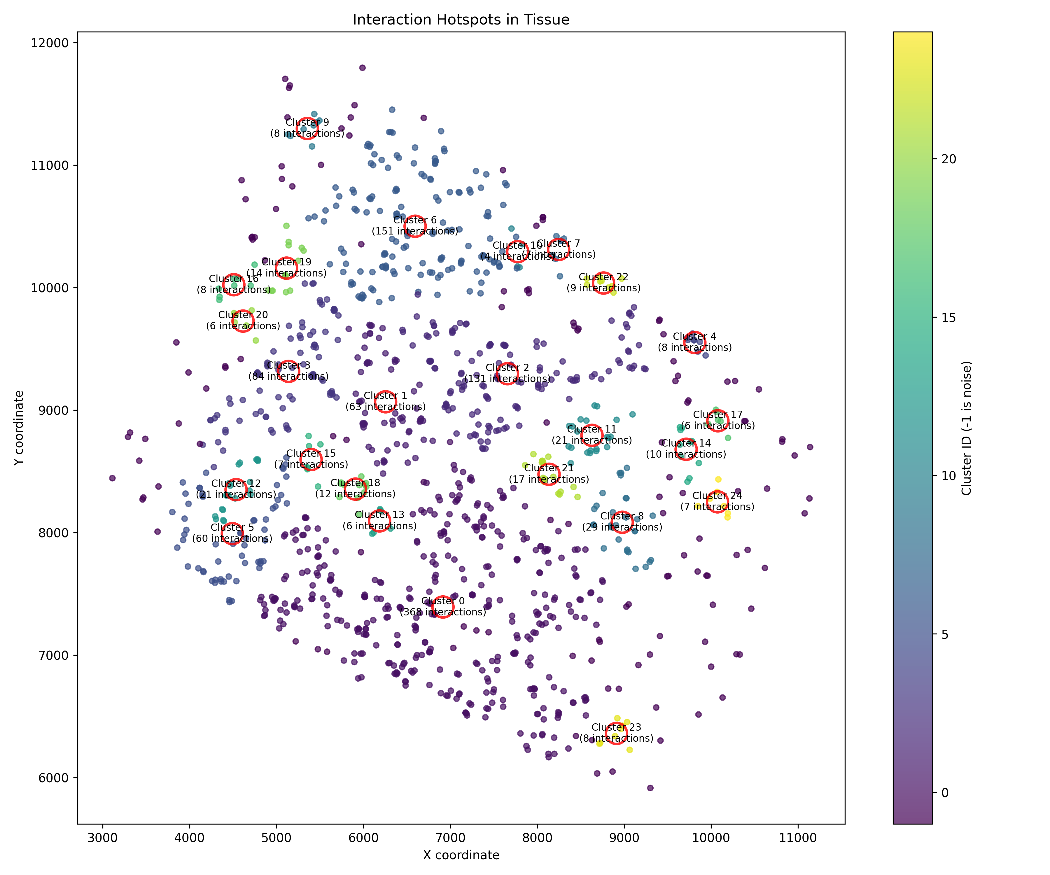
Refining the ligand-receptor analysis
Focus on changes in neurodegenerative diseases.

Slide 20
Potential new direction
Investigating whether ligand-receptor interactions can hint at tissue organization.

Slide 21
What I Love About Karolinska/DIS
The lab environment! – Even though I mostly code, I love being surrounded by cutting-edge research and technology.

